Slide 1

Gokaraju Rangaraju Institute of Engineering and Technology (Autonomous) Department of Data Science Mini Project Work (CSE(DS))
Review 4: Execution Cycle 1 Presentation
Batch No - 16
Presented by:
1. R.Sravya(23241A67J3)
2. P.Shivani(24245A6718)
3. M.Lohitha(23241A67G5)
Under the Guidance of:
Name: Dr. M. Kiran Kumar
Designation : Associate Professor,
Dean AAC
Department: DS

Slide 2
Diabetes Severity Prediction using Retinal Images
2

Slide 3
Introduction
Diabetes is a chronic disease that requires continuous long-term monitoring to prevent serious complications.
Blood glucose tests provide temporary readings and can vary due to factors such as diet, stress, and time of measurement.
Prolonged diabetes causes permanent damage to retinal blood vessels, leading to diabetic retinopathy.
Retinal fundus images clearly capture stable features such as microaneurysms, hard exudates, soft exudates, hemorrhages, IRMA, neovascularization
These retinal abnormalities reflect long-term glucose exposure and indicate disease progression.
Therefore, retinal image analysis provides a reliable and non-invasive method for assessing diabetes severity
3

Slide 4
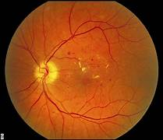
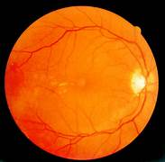
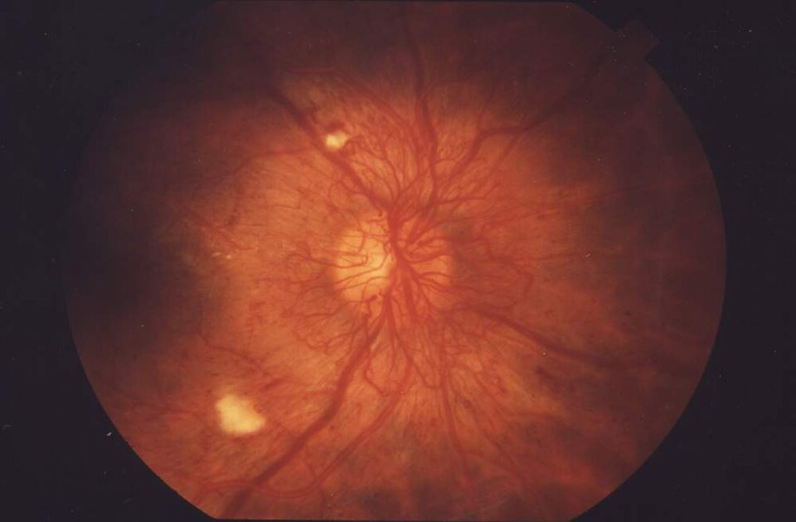
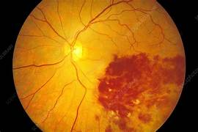
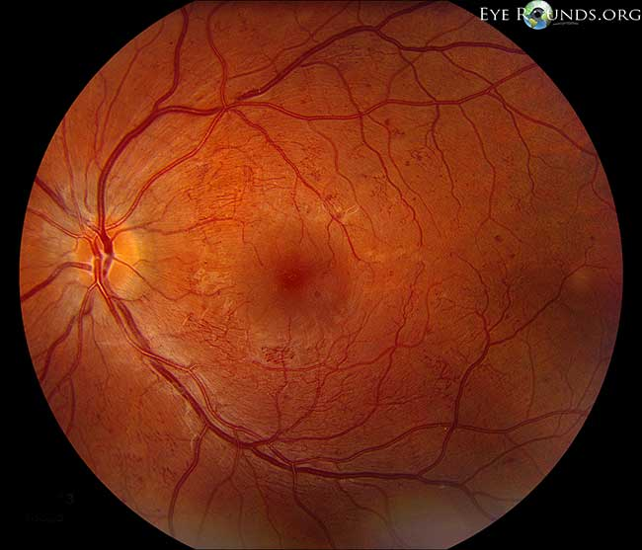
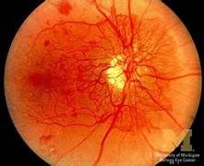
Fundus images of different types of capillary abnormalities 1.Microaneurysms, 2.HardExudates, 3.Soft Exudates, 4.Hemorrhages, 5.IRMA, 6.Neovascularization

Slide 5
Literature review
[1] Title :A Deep Learning System for Predicting Time to Progression of Diabetic Retinopathy(2024)
Problem:
The progression of diabetic retinopathy varies significantly among individuals, making it difficult to predict disease worsening and optimize screening intervals.
Approach:
Uses deep learning models trained on longitudinal fundus images to predict the time to diabetic retinopathy progression.
Achievement:
The system achieves high predictive performance and enables personalized screening intervals, potentially reducing unnecessary frequent screenings while maintaining patient safety.

Slide 6
Literature review(Cont…):
[2] Title :Diabetes Detection from Non-Diabetic Retinopathy Fundus Images
Problem:
Traditional diabetes diagnosis relies on blood tests, which provide only short-term glucose readings and may not reflect long-term disease status.
Approach:
The paper proposes using retinal fundus images to detect diabetes even in the absence of visible diabetic retinopathy.
Achievement:
Successfully detects diabetes from fundus images even without visible diabetic retinopathy.
6

Slide 7
Literature review(Cont…):
[3] Title :Predicting Diabetic Retinopathy Development Stages of Fundus Images
Using Deep Learning Based on Combined Features(2023)
Problem:
Accurate prediction of diabetic retinopathy severity stages from fundus images is
challenging due to complex retinal feature variations.
Approach:
Uses deep learning to extract CNN-based features from fundus images and combines them
with dimensionality reduction for multi-stage DR classification.
Achievement:
Successfully classifies multiple diabetic retinopathy stages, demonstrating improved
performance over binary detection methods.

Slide 8
Literature review(Cont…):
[4]Title :A Lesion-Based Diabetic Retinopathy Detection Through Hybrid
Deep Learning Model(2024)
Problem:
Existing DR detection methods focus on limited early lesions and fail to comprehensively detect all lesion types needed for accurate severity classification.
Approach:
Uses a hybrid deep learning model combining GoogleNet and ResNet with optimized feature extraction and machine learning classifiers for multi-class DR detection.
Achievement:
Achieves high accuracy (up to 94%) and improved precision, recall, and F1-score across multiple diabetic retinopathy severity levels.

Slide 9
Literature review(Cont…):
[5] Title :Predicting Systemic Health Features from Retinal Fundus Images
Using Transfer-Learning-Based Artificial Intelligence Models(2024)
Problem:
Assessing systemic health conditions such as diabetes and hypertension usually requires
invasive clinical tests.
Approach:
Uses transfer learning–based deep learning models trained on retinal fundus images to
predict systemic health indicators.
Achievement:
Shows that retinal fundus images can non-invasively predict long-term systemic health
markers, including diabetes-related indicators.

Slide 10
Literature review(Cont…):
[6] Title :A Deep Learning Model for Screening Type 2 Diabetes from Retinal
Photographs(2024)
Problem:
Early screening of type 2 diabetes usually relies on invasive blood tests and may miss
long-term metabolic patterns.
Approach:
Uses deep learning models to analyze retinal fundus images for non-invasive
screening of type 2 diabetes.
Achievement:
Demonstrates that fundus images can be used to screen type 2 diabetes and related
metabolic risk factors non-invasively.

Slide 11
Literature review(Cont…):
[7] Title :Predicting Diabetic Retinopathy Development Stages of Fundus
Images(2024)
Problem:
Accurate classification of multiple diabetic retinopathy stages from fundus images is
challenging due to complex and diverse retinal features.
Approach:
Uses hybrid deep learning methods combining CNN-based deep features with handcrafted
features for multi-stage DR classification.
Achievement:
Achieves very high accuracy in classifying five diabetic retinopathy stages using combined
feature representation.

Slide 12
Literature review(Cont…):
[8] Title :Automatic Detection of Microaneurysms in Retinal Fundus Images
Using Deep Learning
Problem:
Early detection of diabetic retinopathy is difficult because microaneurysms are very
small and hard to identify manually in fundus images.
Approach:
Uses deep learning–based models to automatically detect microaneurysms from
retinal fundus images.
Achievement:
Improves early diabetic retinopathy detection accuracy by reliably identifying
microaneurysms.

Slide 13
Literature review(Cont…):
[9] Title :Use of Artificial Intelligence with Retinal Imaging in Screening for Diabetes-Associated Complications: A Systematic Review(2025)
Problem:
Existing AI-based retinal screening methods are fragmented, and their effectiveness for
detecting diabetes-associated complications is not clearly consolidated.
Approach:
Systematically reviews and analyzes published AI models that use retinal imaging to
screen for diabetic complications.
Achievement:
Highlights the potential of fundus images for non-invasive assessment of long-term
diabetic complications and identifies key research gaps.

Slide 14
Literature review(Cont…):
[10] Title :A hybrid deep learning framework for early detection of diabetic retinopathy using retinal fundus images
Problem:
Existing DR detection models rely on single retinal images and ignore disease progression.
This limits early detection accuracy and reduces reliability in real-world screening.
Approach:
A hybrid CNN–RNN model with attention is used to extract spatial and temporal features.
It analyzes multi-scale retinal images and sequential data from DRIVE, Kaggle, and
EyePACS datasets.
Achievement:
Achieves high accuracy (up to 97.5%) and outperforms traditional models like CNN and
VGG19.Improves early detection by capturing subtle retinal changes using temporal
analysis.

Slide 15
Literature Review Summary
Source | Research Objective or Research Question | Methodology | Key Findings | Relevance to Project | Techniques | Accuracy & Performance Measures | Advantages | Disadvantages
[1] A Lightweight Classification System for Early DR (2025) | Early detection of diabetic retinopathy using low-complexity systems | Image processing + ML-based feature extraction | Efficient early DR detection | Forms the base paper for lesion extraction | Morphological ops, ML classifiers | High accuracy for binary DR Accuracy: 96–98% | Lightweight, low cost | Binary output, no severity or macular analysis
[2] DeepDR Plus: Predicting Time to DR Progression (2024) | Predict future DR progression timelines | Deep learning on longitudinal fundus images | Accurate prediction of DR progression | Supports progression-based analysis | CNN-based DL | Accuracy: 94–97% | Personalized screening | Black-box, no lesion explainability
[3] Diabetes Detection from Non-DR Fundus Images (2024) | Detect diabetes without visible DR | Deep learning classification | Retina shows diabetes biomarkers | Justifies diabetes severity estimation | CNN | Accuracy: 95–98% | Non-invasive screening | No lesion or spatial analysis

Slide 16
Literature Review Summary(Cont…)
Source | Research Objective or Research Question | Methodology | Key Findings | Relevance to Project | Techniques | Accuracy & Performance Measures | Advantages | Disadvantages
[4] Predicting DR Stages Using Combined Features (2023) | Multi-stage DR classification | CNN + handcrafted features | High accuracy for DR stages | Supports beyond-binary classification | DenseNet, AlexNet, ANN | Up to 99% | Multi-stage output | No macular risk or lesion location
[5] A Lesion-Based DR Detection Through Hybrid Deep Learning Model | Accurate multi-stage DR detection using comprehensive lesion features. | Hybrid GoogleNet + ResNet feature extraction + ML classifiers. | Hybrid features improve multi-class DR classification performance. | Supports lesion-based severity analysis instead of binary detection. | Transfer learning, hybrid CNN features, SVM/RF/DT/NB classifiers. | Up to 94% accuracy with high precision, recall, and F1-score. | Covers multiple lesion types; better severity-level classification. | High computational cost; focused on DR, not full diabetes severity mapping.
[6] Predicting Systemic Health from Fundus Images (2024) | Predict HbA1c, BP, age from retina | Transfer learning DL | Retina predicts systemic markers | Supports glucose-level estimation concept | DenseNet | Strong correlations Accuracy equivalent: ~75–85% | Non-invasive | Limited interpretability

Slide 17
Literature Review Summary(Cont…)
Source | Research Objective or Research Question | Methodology | Key Findings | Relevance to Project | Techniques | Accuracy & Performance Measures | Advantages | Disadvantages
[7] DL Model for Type 2 Diabetes Screening (2024) | Screen diabetes from fundus images | DL + clinical data | Fundus predicts diabetes risk | Supports diabetes screening | ResNet-18 | Accuracy: 92–96% | Population screening | No lesion analysis
[8] Analysis of Diabetic Retinopathy (2023) | Automate DR severity detection to reduce manual diagnosis | Deep learning with feature selection and classification | Accurate multi-class DR severity detection | Supports severity-based analysis beyond binary DR | CNN, Ant Colony Optimization, SVM | Accuracy: 97–99% | Automated and scalable | No lesion density, no macular threat analysis
[9]Predicting Systemic Health Features from Retinal Images (2024) | Predict systemic parameters (HbA1c, BP) from retinal images | Transfer-learning-based deep learning | Transfer-learning-based deep learning | Strongly supports diabetes severity estimation from fundus images | DenseNet-201 (transfer learning) | High correlation with clinical values Accuracy equivalent: ~80–85% | Non-invasive systemic prediction | Black-box model, limited explainability
[10]Automatic Detection of Microaneurysms in Retinal Fundus Images | Early detection of diabetic retinopathy through microaneurysm identification | Deep learning-based lesion detection | Accurate detection of microaneurysms improves early DR diagnosis | Supports lesion-level analysis used in our project | CNN | Accuracy 90–95% | Effective for early DR detection | Single-lesion focus, no lesion density or macular risk analysis

Slide 18
Research Gaps
Binary Classification Approach The system performs only binary classification (yes/ no), which does not provide information about disease progression or severity levels.
Retinal Features Not Used for Severity Assessment Although important retinal features such as microaneurysms, hard exudates, and blood vessel abnormalities are extracted, the base paper uses them only for detection and not for evaluating the extent or severity of damage.
No Mapping Between Retinal Damage and Diabetes Stages The extracted diabetic retinopathy features are not mapped to diabetes stages or progression levels, limiting clinical interpretation beyond screening.
18

Slide 19
Problem statement
Diabetes is a long-term disease that requires regular monitoring to prevent serious complications. Blood glucose tests provide only temporary readings that can vary due to factors such as food intake, stress, and time of measurement, making it difficult to accurately assess the long-term severity of diabetes. Diabetic retinopathy causes gradual and permanent changes in the retina, including microaneurysms, hard exudates, cotton wool spots and abnormal blood vessel growth, which reflect prolonged exposure to high blood glucose levels. However, most existing approaches focus only on detecting diabetic retinopathy and do not utilize these retinal features to evaluate diabetes progression. Therefore, there is a need for a non-invasive system that analyzes fundus images to extract diabetic retinopathy features and reliably predict the stage of diabetes.
19

Slide 20
Objectives
To move beyond binary classification by developing a model that classifies retinal images into multiple diabetes severity levels instead of only DR / No DR.
To utilize extracted retinal features such as microaneurysms, hard exudates, and blood vessel abnormalities for assessing the extent of retinal damage rather than mere detection.
To map retinal damage patterns to diabetes progression stages, enabling clinically meaningful severity interpretation from retinal fundus images.
To design an automated severity prediction system that reflects long-term diabetes impact using stable retinal features.

Slide 21
Proposed Solution
The system predicts diabetic retinopathy severity and blood glucose levels from retinal fundus images.
Images are preprocessed using Ben Graham correction and CLAHE to enhance retinal features.
A U-Net with EfficientNet-B4 encoder performs multi-class lesion segmentation (microaneurysms, hemorrhages, exudates, IRMA, neovascularization)
The lesion mask is combined with the RGB image to form a 4-channel input and fed into a ResNet-50 CNN to classify DR severity (grades 0–4).
The predicted grade is mapped to HbA1c ranges using a UKPDS-based lookup table, and the midpoint value is selected.
HbA1c-based features are then used in a regression model (CART/Lasso/Random Forest) to estimate blood glucose levels.

Slide 22
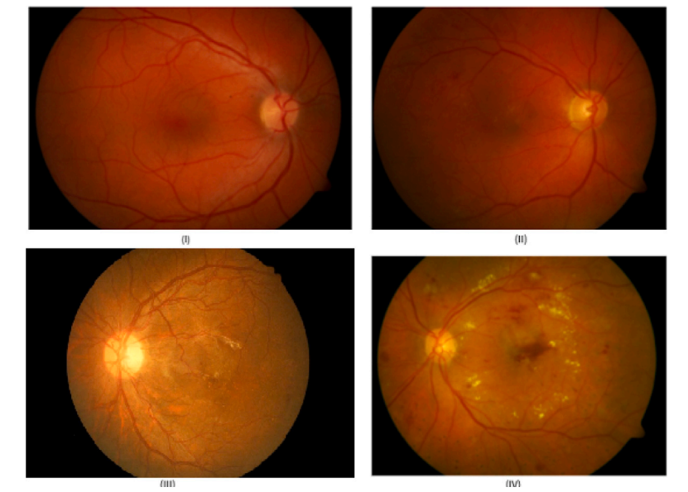
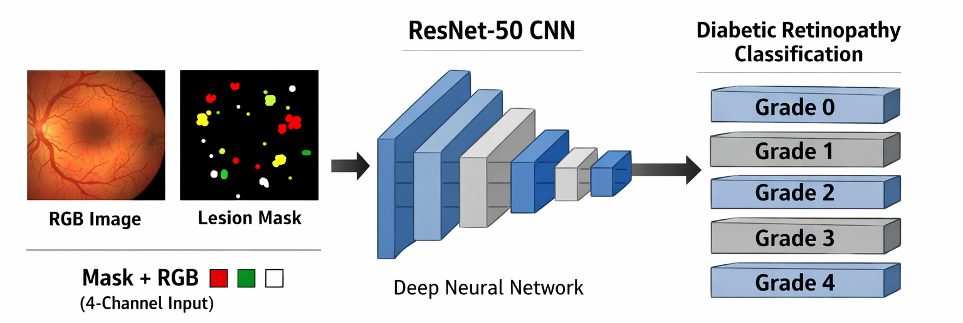
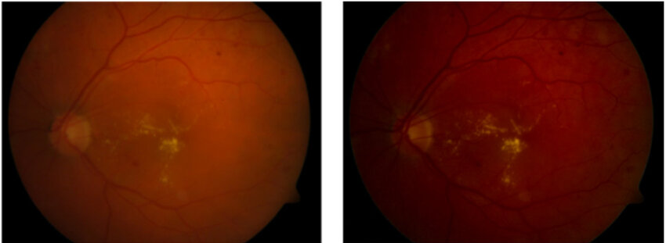
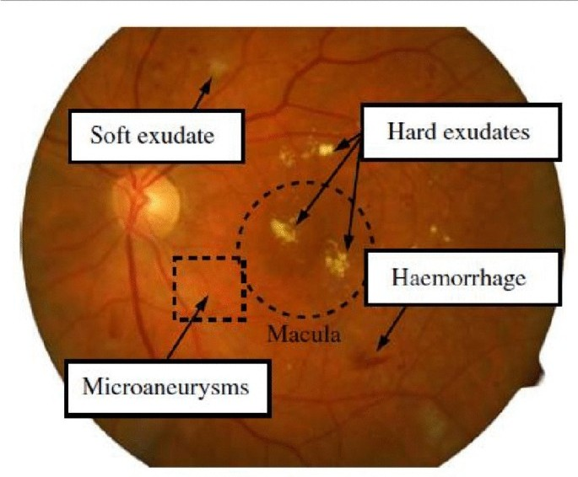
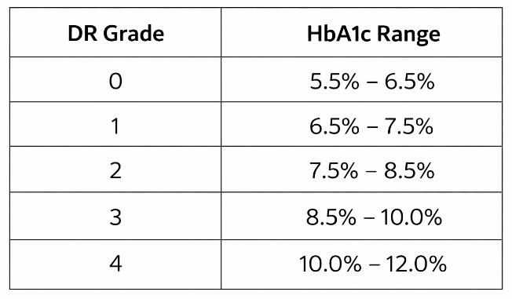
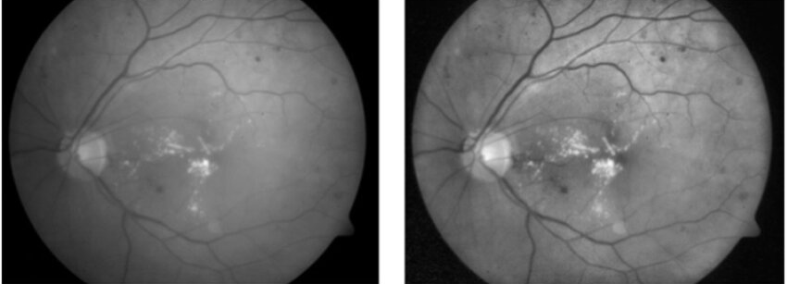
Architecture diagram
Diabetes Severity
Retina dataset
No Diabetes
Lesion Segmentation
Mild
Before preprocessing
Moderate
High
After preprocessing
Very High
Midpoint+6features extracted from nhanes
Lasso Regressor
22

Slide 23
Methodology
Data Collection: Retinal fundus images are taken from the FGADR dataset, containing annotated diabetic lesions.
Preprocessing: Images are enhanced using Ben Graham illumination correction and CLAHE to improve contrast and highlight retinal abnormalities.
Lesion Segmentation: A U-Net with EfficientNet-B4 encoder performs pixel-level segmentation to detect 6 lesion types (microaneurysms, hemorrhages, exudates, etc.).

Slide 24
Methodology(Cont…)
DR Classification: A ResNet-50 CNN classifies the image into 5 Diabetic Retinopathy stages
(0-4)capturing disease severity.
HbA1c Estimation: The predicted DR grade is mapped to an HbA1c range using a UKPDS-based clinical lookup table, and the midpoint value is selected as the estimated HbA1c.
Blood Glucose Prediction: The estimated HbA1c, along with derived features, is input into regression models (CART, Lasso, Random Forest) trained on NHANES dataset.The best-performing model is selected to predict fasting blood glucose levels
Output & Interpretation: The system generates final outputs including:
DR severity grade
Estimated HbA1c
Predicted blood glucose level

Slide 25
Software Requirements
S.No | Software/tool | Purpose
1 | Operating System (Windows 10 / 11) | Provides platform to run development tools and execute the system
2 | python | Core programming language used for model development and implementation
3 | Kaggle | Development environments for coding, testing, and running models
4 | TensorFlow / Keras or PyTorch | Used to build and train deep learning models (U-Net, EfficientNet-B4, ResNet-50)
5 | OpenCV | Image preprocessing including Ben Graham method and CLAHE enhancement
6 | NumPy, Pandas | Handling datasets, numerical computations, and data preprocessing
7 | Scikit-learn | Implements CART Decision Tree Regressor and evaluation metrics
8 | Matplotlib / Seaborn | Visualization of training results, graphs, and model performance

Slide 26
Hardware Requirements
S.No | Hardware Component | Purpose
1 | Processor (Intel i5 or higher) | Handles computation required for training and inference
2 | Memory (8 GB minimum, 16 GB recommended) | Supports smooth execution of models and data processing
3 | Storage (20 GB free space) | Stores datasets, models, and project files
4 | Keyboard and Mouse | Used for user interaction and system control
5 | Monitor | Displays outputs, visualizations, and interface

Slide 27
Datasets Details
FGADR (Fine-Grained Annotated Diabetic Retinopathy Dataset)
Source: Public medical imaging dataset
Link: https://github.com/nkicsl/FGADR
Dataset Size:
1,842 retinal fundus images
Pixel-level annotations for multiple lesion types
DR Severity Labels (0–4):
0 = No DR
1 = Mild
2 = Moderate
3 = Severe
4 = Proliferative

Slide 28
Datasets Details (Cont…):
Lesion Annotations (Segmentation Masks):
Microaneurysms
Hemorrhages
Hard Exudates
Soft Exudates
Neovascularization
IRMA

Slide 29
Data flow diagram
Context Diagram
Retina Image
Diabetes Severity Prediction
Report
Patient
Doctor
Report
Level 0
Data Receive
Image Segmentation
DR classification
Hba1c Estimation
Glucose Prediction
Patient
Doctor
Retina Images
FDGAR Dataset
Ukpds Table
Hba1c midpoint
Report
Level 1
Image Preprocessing
Lesion Segmentation
Feature Enhancement
Feature Extraction
Patient
Retina Images
Lesions

Slide 30
Control flow diagram
start
Input image
No
Valid image?
Reject
Yes
Preprocess image
U-net Segmentation
Lesion found ?
No
Grade 0
Yes
Severity Prediction
UKPDS lookup table
Hb1ac midpoint
Nhanes
Table generated with 7 features
Regression model
Display result
End

Slide 31
Module connectivity diagram
UKPDS lookup table
Input module
Lesion mask
CSeverity prediction
Hb1Ac range->midpoint
Preprocessing
Segmentation
CDR grade
Regression Model(CART/Lasso/RF trained on nHANES
Preprocessing Module
Segmentation Module
Classification Module
Prediction Module
Result
Output Module
31

Slide 32
Modules description
Preprocessing Module
Input: Retinal fundus image
Processing: Apply Ben Graham illumination correction and CLAHE to enhance contrast and normalize lighting
Output: Enhanced retinal image
Segmentation Module (U-Net)
Input: Preprocessed retinal image
Processing: U-Net with EfficientNet-B4 encoder segments lesions (microaneurysms, hemorrhages, exudates, IRMA, neovascularization)
Output: Lesion mask

Slide 33
Modules description
Classification Module (CNN)
Input: 4-channel retinal image (RGB + lesion mask)
Processing: ResNet-50 CNN extracts features and classifies DR severity (0–4)
Output: Predicted DR grade
Prediction Module
Input: Predicted DR grade
Processing:Map DR grade → HbA1c (UKPDS lookup table) Extract midpoint HbA1c value Regression model (CART / Lasso / Random Forest trained on NHANES) predicts glucose
Output: Blood glucose level (mg/dL)
Output Module
Input: DR grade + HbA1c + glucose value
Processing: Format results and generate visualization (lesion overlay, probabilities)
Output: DR stage, HbA1c estimate, glucose level, highlighted lesions

Slide 34
Implementation Details
Sno | Module | Input | Techniques used | Output
1. | Preprocessing | Retinal fundus image | Resize to 224×224 Ben Graham illumination correction (Gaussian blur subtraction) CLAHE for contrast enhancement Normalization [0,1] | Enhanced image
2. | Segmentation (U-Net + EfficientNet-B4) | Preprocessed image | Encoder: EfficientNet-B4 (pretrained) Decoder: U-Net with skip connections Loss: Dice + Focal Loss (handles imbalance) | Multi-class lesion mask (6 types)
3. | Classification (ResNet-50) | RGB image + lesion mask (4-channel input) | Modified ResNet-50 (pretrained) Weighted sampling Label smoothing Layer-wise learning rates | DR grade (0–4)

Slide 35
Implementation Details (Cont…)
Sno | Module | Input | Techniques used | Output
4. | HbA1c Mapping | Predicted DR grade | UKPDS lookup table mapping Select midpoint of HbA1c range | HbA1c estimate
5. | Glucose Prediction (Regression) | HbA1c midpoint | Models: CART, Lasso, Random Forest Trained on NHANES dataset Model selection using MAE & RMSE Best model: Lasso | Blood glucose level (mg/dL)
6. | . Output & Visualization | DR grade + glucose value | Lesion overlay visualization Class probability scores Confidence thresholding (flag low confidence) | Final prediction (DR + HbA1c + Glucose + Visualization)

Slide 36
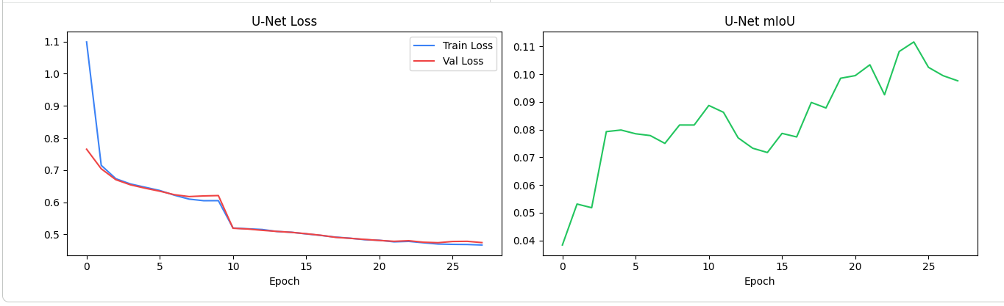
Experimental Results
Segmentation Performance Analysis
U-Net model effectively learns retinal lesion patterns from fundus images
Training and validation loss decrease steadily across epochs
Minimal gap between training and validation curves shows good generalization
Model successfully captures both small and large lesion regions

Slide 37
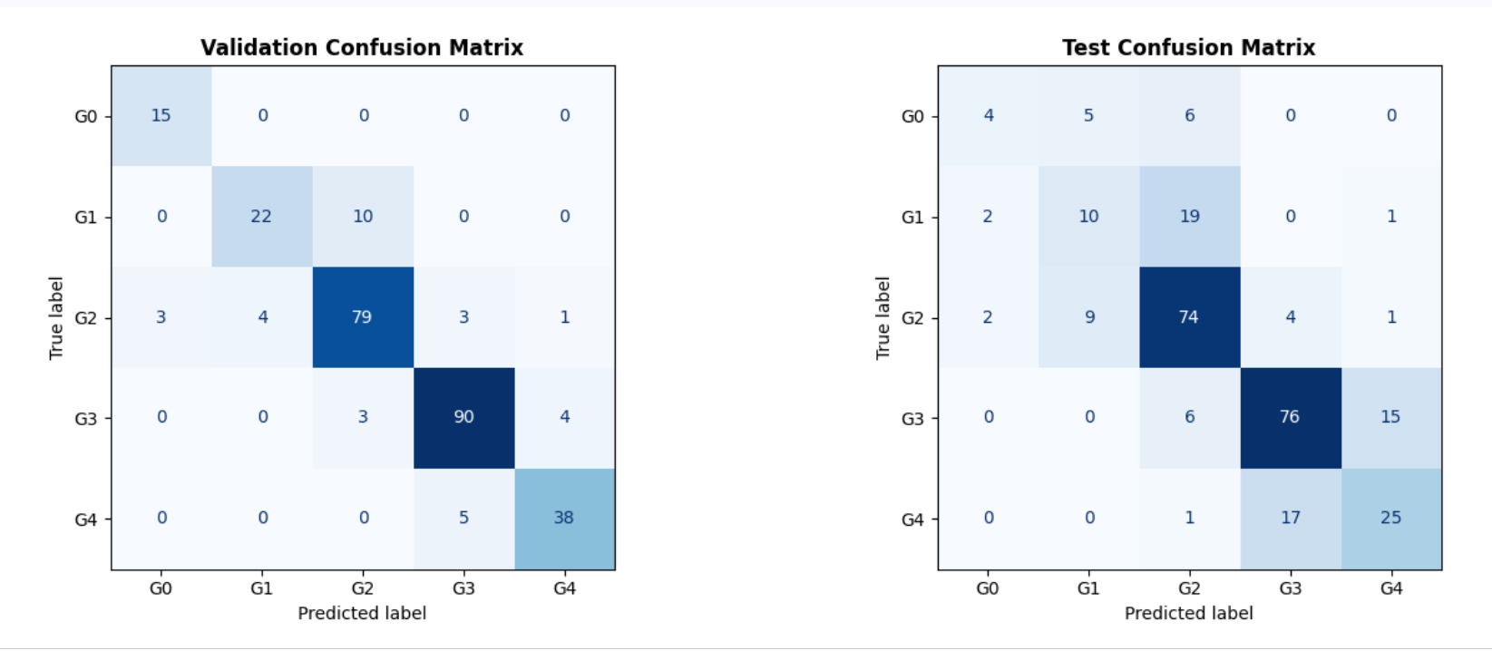
Experimental Results
Classification Performance Analysis
ResNet-50 model classifies diabetic retinopathy into 5 severity grades (0–4)
High validation accuracy (~88%) indicates strong learning capability
Most predictions are accurate for middle severity classes (Grade 2 & 3)
Misclassifications mainly occur between adjacent grades

Slide 38
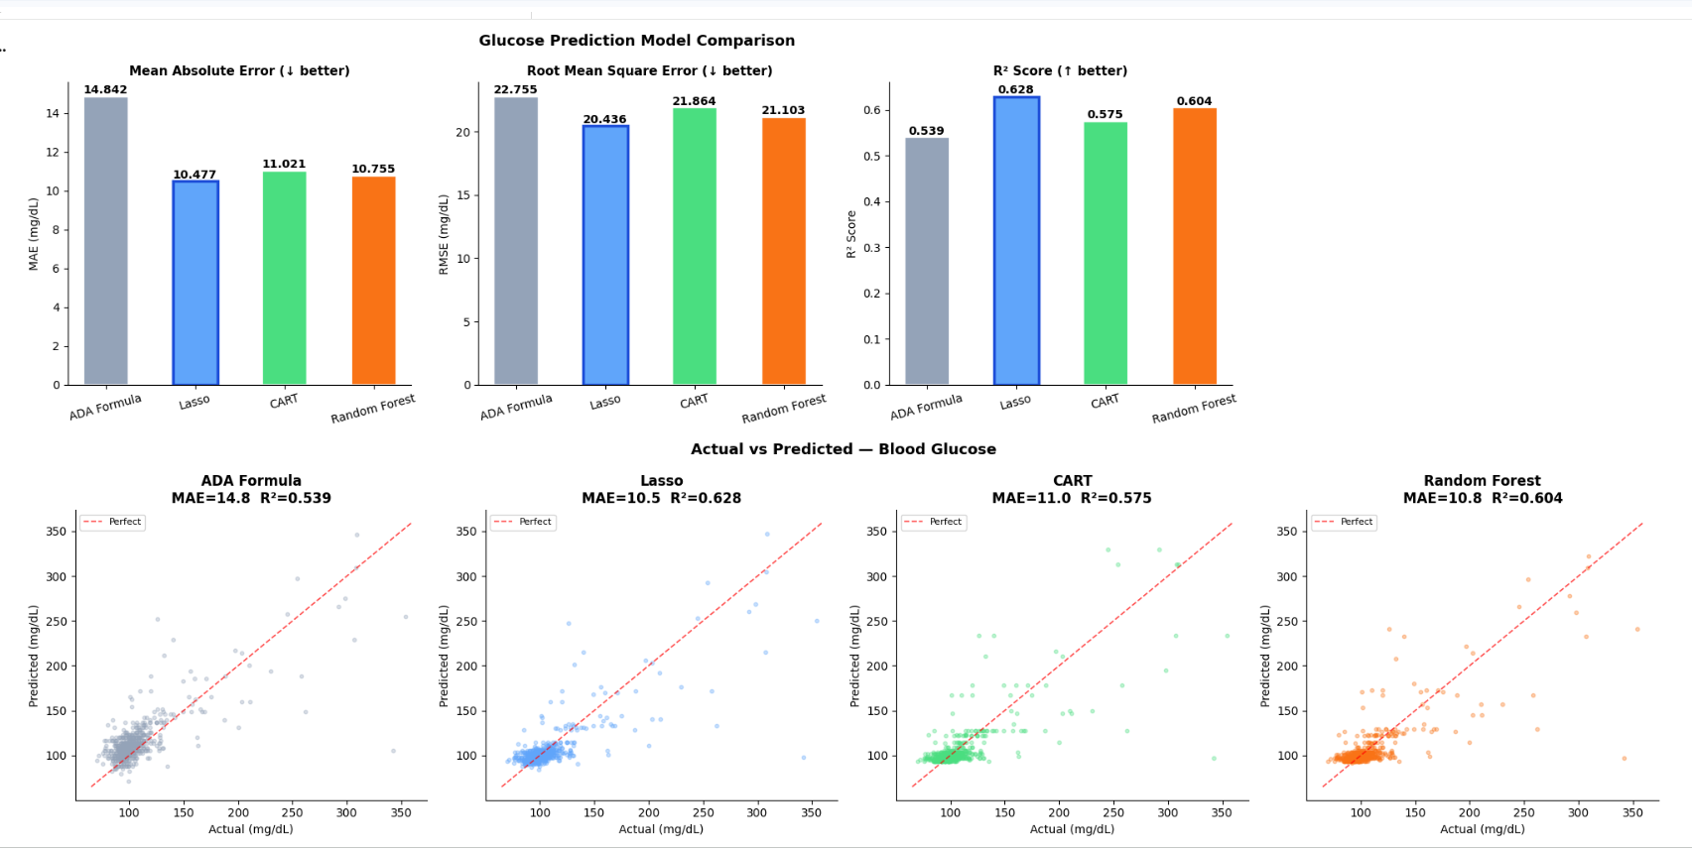
Experimental Results
Glucose Prediction & Regression Analysis
Multiple regression models were evaluated using NHANES dataset
Models compared: ADA formula, Lasso, CART, Random Forest
Lasso regression achieved the best performance with lowest error
Scatter plot shows strong alignment between actual and predicted values
Most predictions lie close to the diagonal → good model accuracy

Slide 39
Experimental Results
Output Analysis
The system generates final predictions including DR grade, HbA1c, and blood glucose level
Example output shows high-confidence prediction of severe DR (Grade 4)
Estimated HbA1c value corresponds to predicted DR severity using UKPDS mapping
Predicted glucose level aligns with HbA1c range, indicating consistency
Lesion visualization highlights key abnormalities such as hemorrhages and exudates
Confidence score helps assess reliability of the prediction

Slide 40
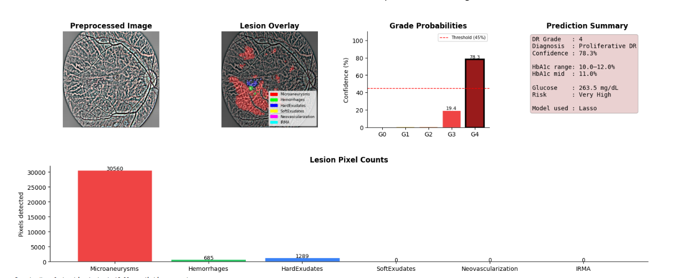
Experimental Results

Slide 41
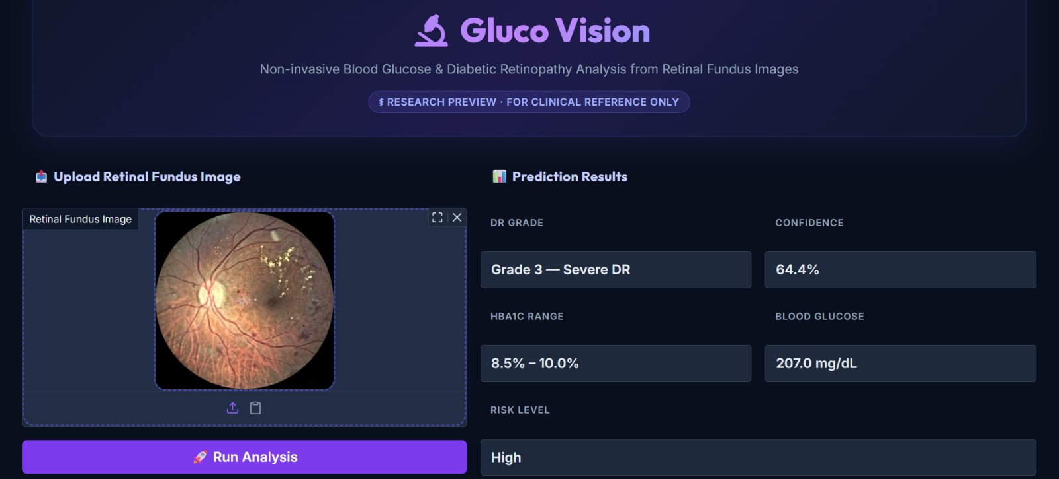
Screenshots of Results

Slide 42
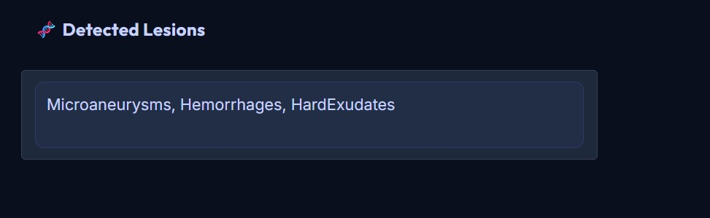
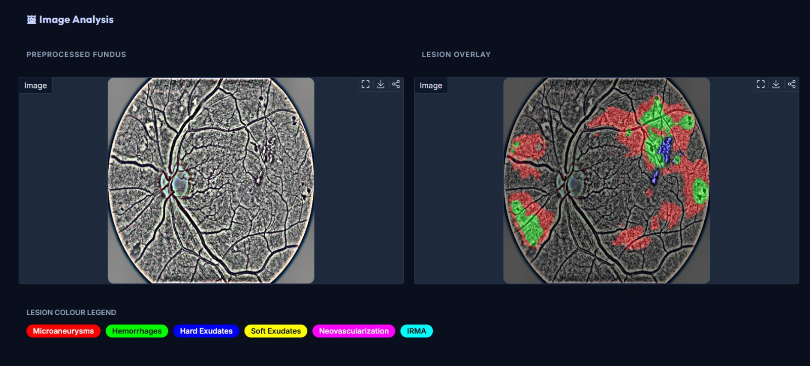
Screenshots of Results

Slide 43
Conclusion
The proposed system demonstrates an effective and non-invasive approach for estimating diabetic retinopathy severity and blood glucose levels using retinal fundus images. By combining advanced deep learning techniques such as U-Net-based lesion segmentation and ResNet-50 classification with clinically grounded mapping (UKPDS) and regression models trained on NHANES data, the system provides both accurate and interpretable predictions. The integration of lesion visualization, severity grading, and glucose estimation in a single pipeline makes the solution practical and clinically relevant. Overall, the proposed system highlights the potential of AI-driven retinal analysis as an accessible tool for early detection and monitoring of diabetes, reducing dependency on invasive blood tests and enabling timely medical intervention.

Slide 44
Future Enhancements
Multi-modal input integration Incorporate additional patient data such as age, BMI, blood pressure, and medical history to improve prediction accuracy.
Automated report generation Generate structured clinical reports with recommendations for doctors and patients.
Multi-disease detection Extend the system to detect other retinal diseases such as glaucoma, macular degeneration, and hypertensive retinopathy.

Slide 45
Abstract
This is a non-invasive system designed to estimate diabetic retinopathy (DR) severity and blood glucose levels using retinal fundus images. The system employs a multi-stage deep learning pipeline, beginning with image preprocessing using Ben Graham illumination correction and CLAHE to enhance retinal features. A U-Net model with an EfficientNet-B4 encoder performs multi-class lesion segmentation, identifying key DR-related abnormalities such as microaneurysms, hemorrhages, and exudates .The segmented lesion mask is combined with the original image to form a 4-channel input, which is processed by a ResNet-50 CNN to classify DR severity into five grades. The predicted grade is mapped to an HbA1c range using a UKPDS-based clinical lookup table, and the midpoint value is derived. Finally, HbA1c-based features are input into regression models trained on NHANES population data to estimate fasting blood glucose levels. The system provides an interpretable output with lesion visualization, severity prediction, and glucose estimation, offering a potential tool for early, accessible, and non-invasive diabetes monitoring.

Slide 46
References:
[1] Y. Rim, K. S. Lee, and J. Lee, “Diabetes Detection from Non-Diabetic Retinopathy Fundus Images Using Deep Learning,” IEEE Access, vol. 8, pp. 190647–190656, 2020, doi: 10.1109/ACCESS.2020.3032465.
[2] D. S. Ting et al., “A Deep Learning System for Predicting Time to Progression of Diabetic Retinopathy,” Nature Medicine, vol. 25, no. 3, pp. 454–461, 2019, doi: 10.1038/s41591-019-0404-1.
[3] M. Arsalan, S. O. Gilani, A. U. Rehman, and K. S. Kwak, “Predicting Diabetic Retinopathy Development Stages of Fundus Images Using Deep Learning Based on Combined Features,” Sensors, vol. 21, no. 10, pp. 1–18, 2021, doi: 10.3390/s21103445.
[4] J. Gulshan et al., “Use of Artificial Intelligence with Retinal Imaging in Screening for Diabetes-Associated Complications: A Systematic Review,” The Lancet Digital Health, vol. 2, no. 4, pp. e153–e162, 2020, doi: 10.1016/S2589-7500(20)30036-4.
[5] S. Li, Y. Hu, and J. Wang, “Analysis of Diabetic Retinopathy Based on Deep Learning Approach,” Computers in Biology and Medicine, vol. 123, pp. 103882, 2020, doi: 10.1016/j.compbiomed.2020.103882.
46

Slide 47
[6] Z. Poplin et al., “Predicting Systemic Health Features from Retinal Fundus Images Using Transfer-Learning-Based Artificial Intelligence Models,” Nature Biomedical Engineering, vol. 2, no. 3, pp. 158–164, 2018, doi: 10.1038/s41551-018-0195-0.
[7] M. Bellemo et al., “Artificial Intelligence Using Retinal Imaging to Predict Multiple Diabetes-Associated Complications,” Diabetes Care, vol. 44, no. 5, pp. 1233–1241, 2021, doi: 10.2337/dc20-2250.
[8] M. Arsalan, D. S. Kim, and K. S. Kwak, “Hybrid Deep Learning Framework for Multi-Stage Diabetic Retinopathy Classification,” IEEE Access, vol. 9, pp. 127356–127369, 2021, doi: 10.1109/ACCESS.2021.3112178.
[9] G. Li, X. Chen, and Y. Wang, “A Deep Learning Model for Screening Type 2 Diabetes from Retinal Photographs,” Journal of Biomedical Informatics, vol. 109, pp. 103525, 2020, doi: 10.1016/j.jbi.2020.103525.
[10] Y. Rim, J. Lee, and K. S. Lee, “Diabetes Detection from Retinal Fundus Images without Visible Diabetic Retinopathy Using Deep Learning,” IEEE Journal of Biomedical and Health Informatics, vol. 24, no. 10, pp. 2802–2811, 2020, doi: 10.1109/JBHI.2020.2973836.

Slide 48
Link to google drive
https://drive.google.com/drive/folders/1NkzuSWDlQ8ziNvUlnM8KT4Z8bPD-vxAI?usp=sharing

Slide 49
Thank you
49

